Slide 1








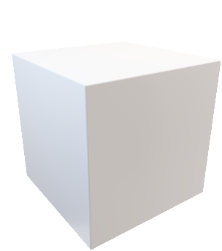
gaze forward

Slide 2
眼动向前射线

Slide 3
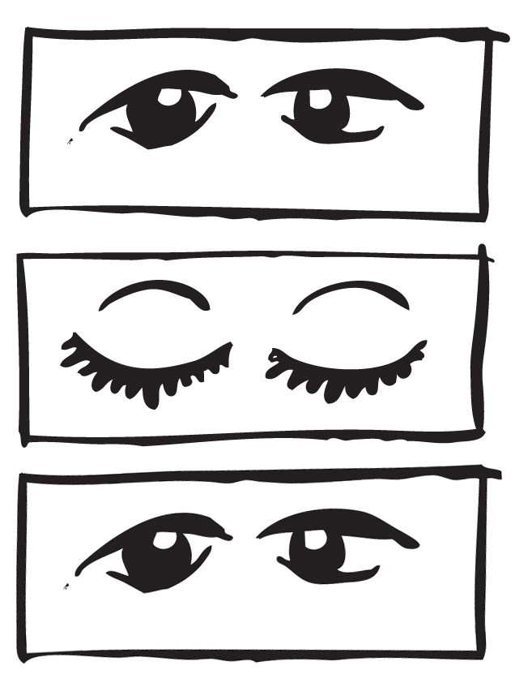
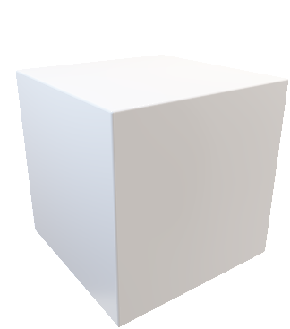


y
y
y
x
x
x
head forward
gaze forward
gaze forward
1
2
3
4
···
double blinking to confirm and select the target object
progress bar getting full to enter a certain manipulation mode (e.g., rescaling)
double blinking to confirm the manipulation and return to “Clover”
Return to browsing or continue manipulating the current object

Slide 4
y
y
y
x
x
x
头动向前射线
眼动向前射线
眼动向前射线
1
2
3
4
···

